Slide 1
ANN - Lab 4 Hopfield Networks
Feiyang Liu
Junxun Luo
Feb 22nd, 2017

Slide 2
How it works...
Learning patterns
Calculate weight matrix
Hebbian learning
Weight matrix
partial
patterns
Update patterns
Syn- or asynchronous update
Completed patterns

Slide 3
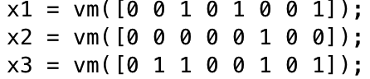
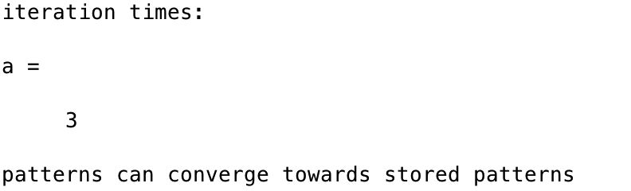
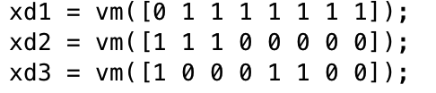
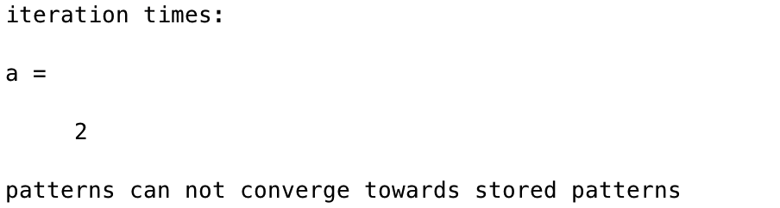
Attractors and convergence
Change the starting pattern even more dissimilar (more than half are wrong)
Observation:
Output pattern converges but not to the stored patterns
Not any input can converge to stored patterns, only that have some similarities.

Slide 4
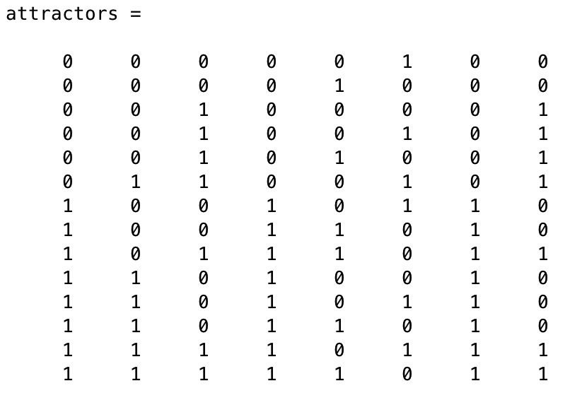
Attractors and convergence
Find all attractors
14 attractors in total with 8 units

Slide 5
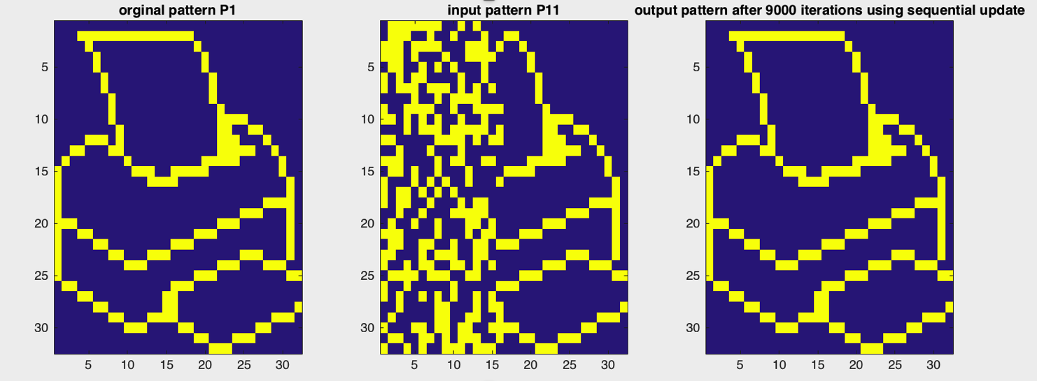
Sequential update
Only update one unit per iteration
Using p1, p2, p3 to train Weight matrix; Input : p11 (degraded version of p1)
The output has the same pattern as the stored pattern P1

Slide 6
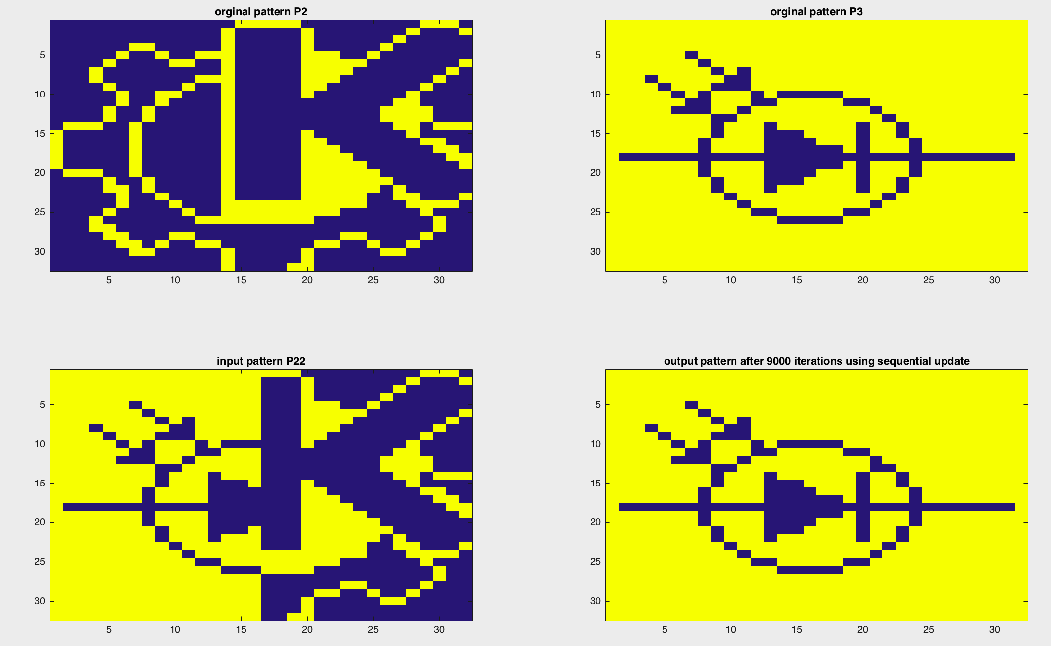
Sequential update
Using p1, p2, p3 to train Weight matrix; Input : p22 (a mixture of p2 and p3)
The output pattern converge to the stored pattern p3

Slide 7
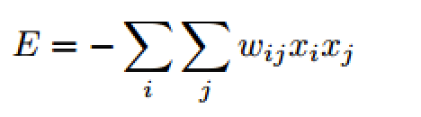
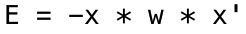
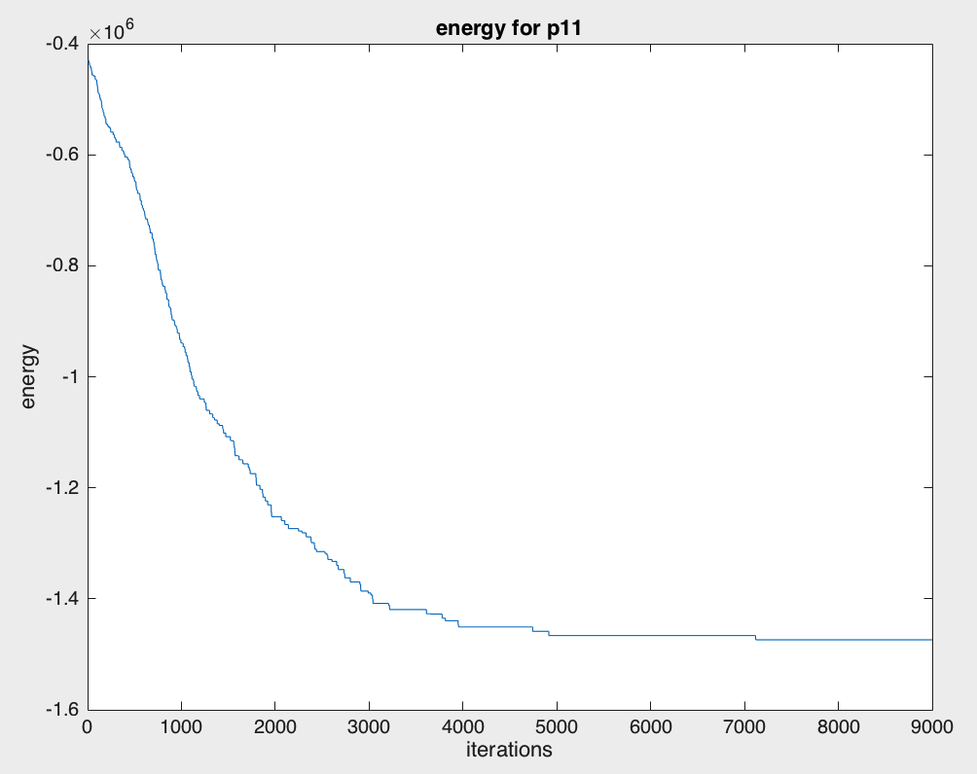
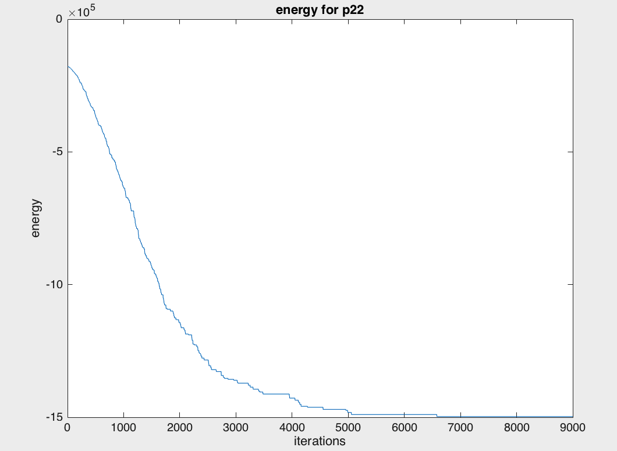
Energy
In MATLAB, we have
Energy for p11 with iterations
Energy for p22 with iterations
With output converging, the energy also tends to converge to a lower level.
Lower energy level, easier to reach the local minimal (attractors)
Higher the input energy, more iterations needed
(p22 has higher energy, more than 7000 iterations)

Slide 8
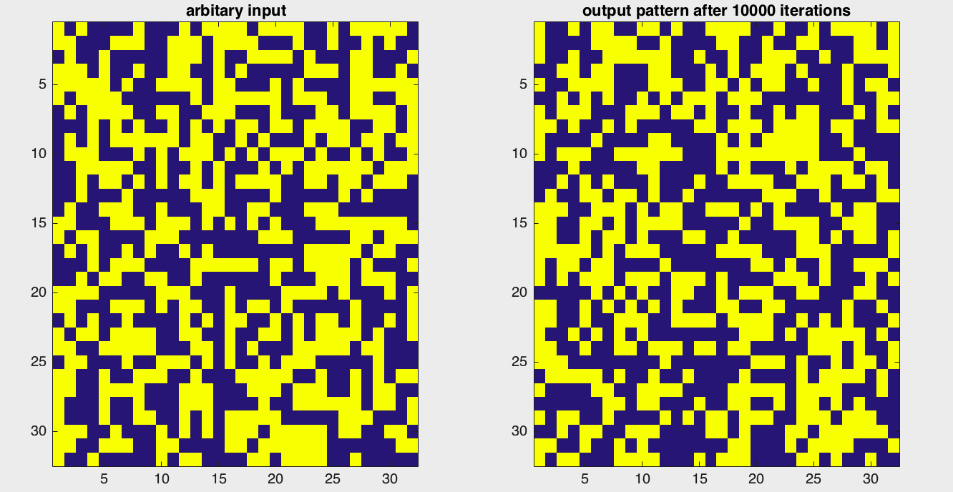
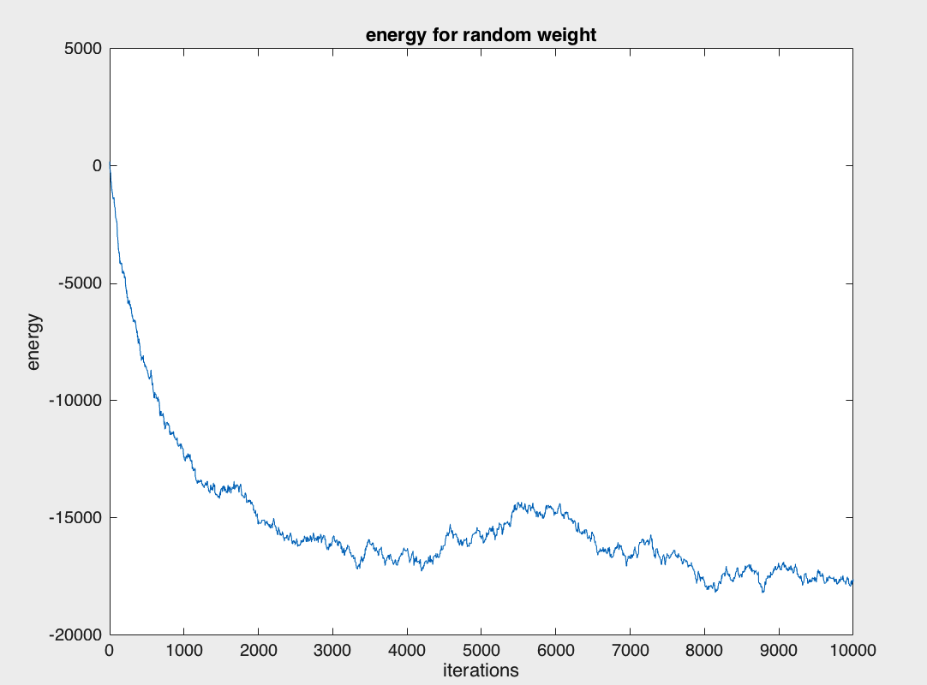
Energy
normally distributed random weight matrix:
With Random input
Hard to converge

Slide 9
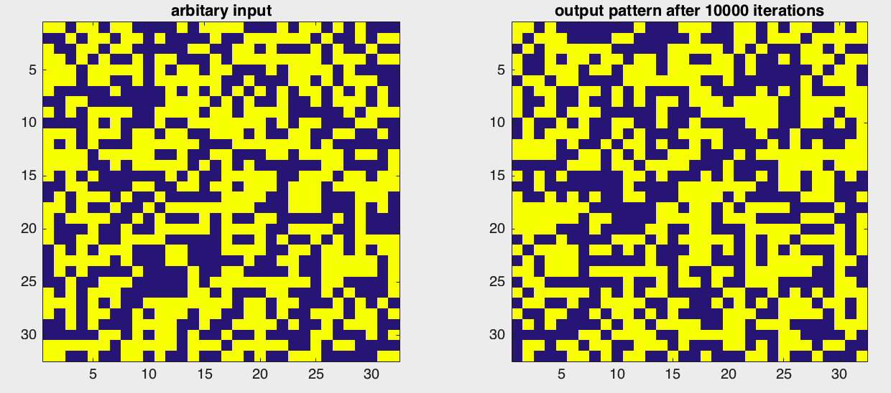
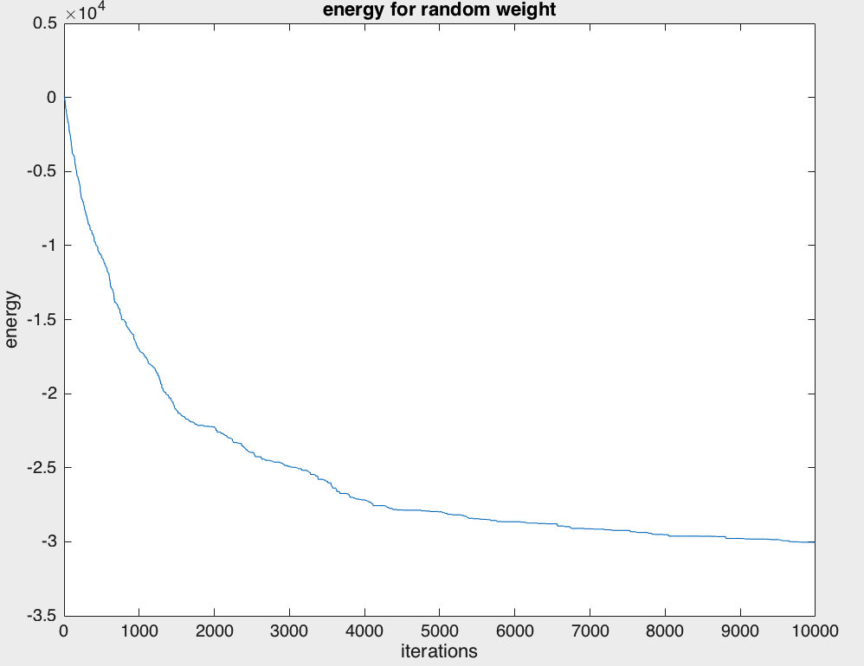
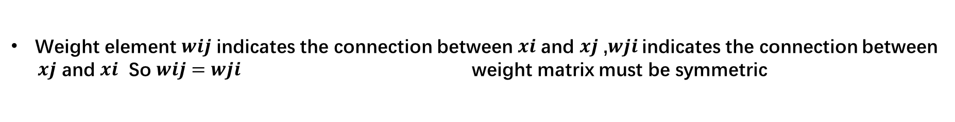
Energy
normally distributed random but still symmetric weight matrix:
With Random input
Energy converges

Slide 10
Distortion Resistance
Train with p1-p3, also add noise to p1-p3
Observations:
Good restoration when noise ratio < 0.5
Retrive inverse patterns when noise ratio > 0.5

Slide 11
Distortion Resistance
Train with p1-p3, also add noise to p1-p3
noise ratio = 0.2
noise ratio = 0.4
noise ratio = 0.6
noise ratio = 0.8

Slide 12
Capacity
Train with p1-p4, no noise added
Observations:
Three patterns could be safely stored
Abrupt increase in errors

Slide 13
Capacity
Train with random patterns - error test
Observations:
Around 150 patterns could be safely stored (0.138N = 0.138*1024 = 141)
Higher input energy, increased capacity

Slide 14
Capacity
Train with random patterns - stability test
with self-connections
no self-connections
Observations:
Increase patterns -> decayed stability
No self-connections -> hard to remain at current state -> even worse stability

Slide 15
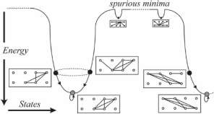
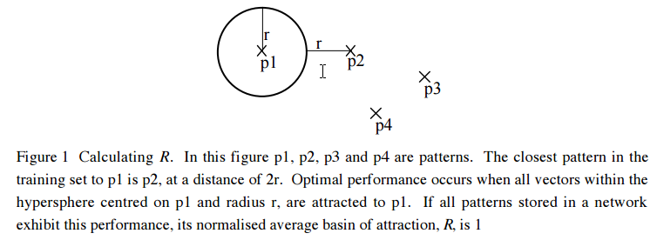
Capacity - Sparse Patterns in Binary Network
In the binary network, the performance falls when the bias (average activity) is raised
More Bias ---> More 1 states ---> High attraction of 1 states
---> Training sets more correlated
Training sets more correlated ---> Network tend to go far from OPTIMIZATION
---> Converge to local minima of energy (spurious states)
Stored patterns: Large energy basins
Spurious patterns: Small energy basins

Slide 16
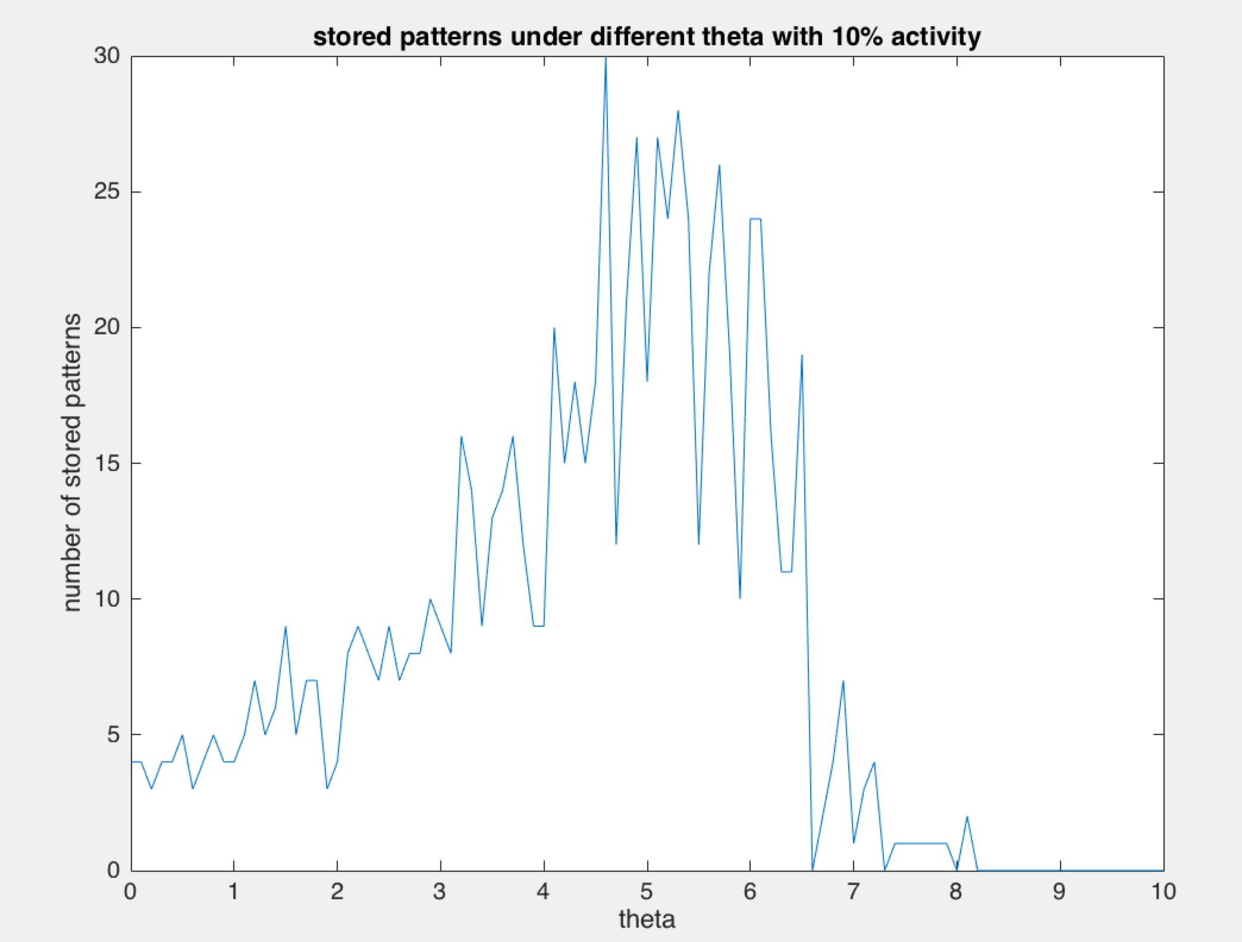
Capacity - Sparse Patterns in Binary Network
Observations:
A certain theta maximize the number of stored patterns
This certain theta Theta compensate the bias of patterns

